Slide 1
Integration Testing with Spring
Cătălin Tudose
PhD in Computer Science, JAVA and Web Technologies Expert
@CatalinTudose5

Slide 2

Who I Am
6 courses and 1 project at Pluralsight (Java testing, Spring, Java persistence)
Author at Manning

Slide 3

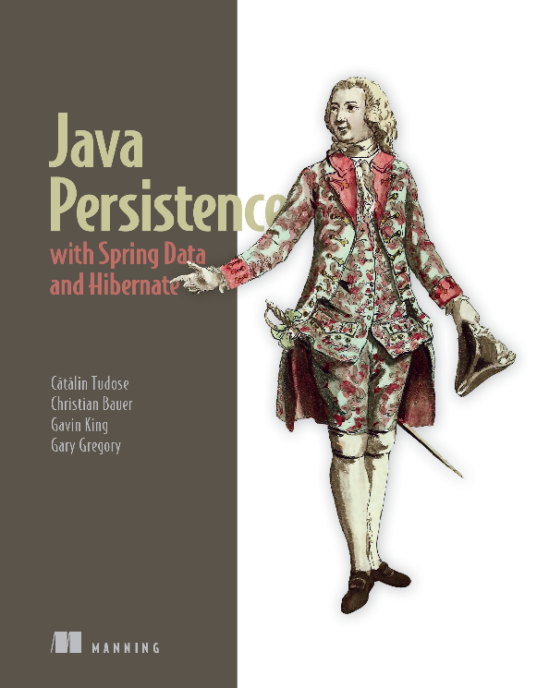
Who I Am
ctwjavazone21

Slide 4
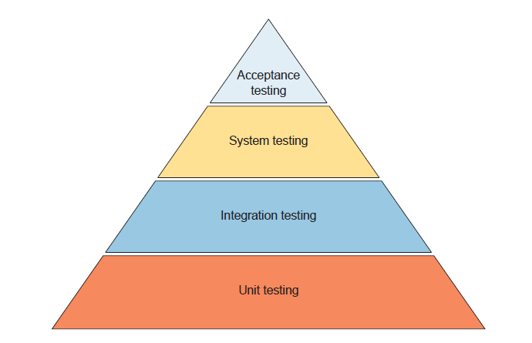
Integration Testing

Slide 5
Spring TestContext Framework
Generic, annotation-driven integration testing support
Agnostic of the testing framework

Slide 6
@DirtiesContext
The underlying Spring ApplicationContext has been dirtied during the execution of a test and should be closed
The Spring container is recreated for any test that needs the context

Slide 7
@DirtiesContext Functionality
Create context and cache
Inject Dependencies
Execute @BeforeEach
Repeat for each test
Execute test method
Execute @AfterEach
Remove the cached context

Slide 8
@Transactional Execution
@Transactional annotation
The transaction is rolled back at the end of each execution

Slide 9
@Transactional REQUIRES_NEW
method1
Transaction 1
Launch transactional method2
with REQUIRES_NEW
Transaction 1
suspended
Transaction 2
Transaction 1
Commit
Transaction 2
Continue
Transaction 1
Commit
Transaction 1

Slide 10
@DirtiesContext vs @Transactional

Slide 11
@DirtiesContext vs @Transactional

Slide 12
Transactions Management
@BeforeTransaction
@AfterTransaction
@Rollback
@Commit

Slide 13
@ActiveProfiles
Class level annotation
Determines the active bean definition profiles when loading an ApplicationContext for an integration test

Slide 14
@TestExecutionListener
Configures TestExecutionListener implementations to be registered with the TestContextManager
More flexible and reusable than @BeforeEach, @AfterEach

Slide 15
Testing Spring REST
Test the HTTP API from the controller
Test without starting the server

Slide 16
WebFlux Testing
WebClient
WebTestClient

Slide 17
Thank you!

